Slide 1
Element Equations
for 2-terminal elements
v
i
resistor
capacitor
inductor
memristor
q
Ø
Resistor: An element that has an algebraic equation between v and i.
Inductor: An element that has an algebraic equation between Ø and i.
Capacitor: An element that has an algebraic equation between v and q.
Memristor: An element that has an algebraic equation between Ø and q.

Slide 2
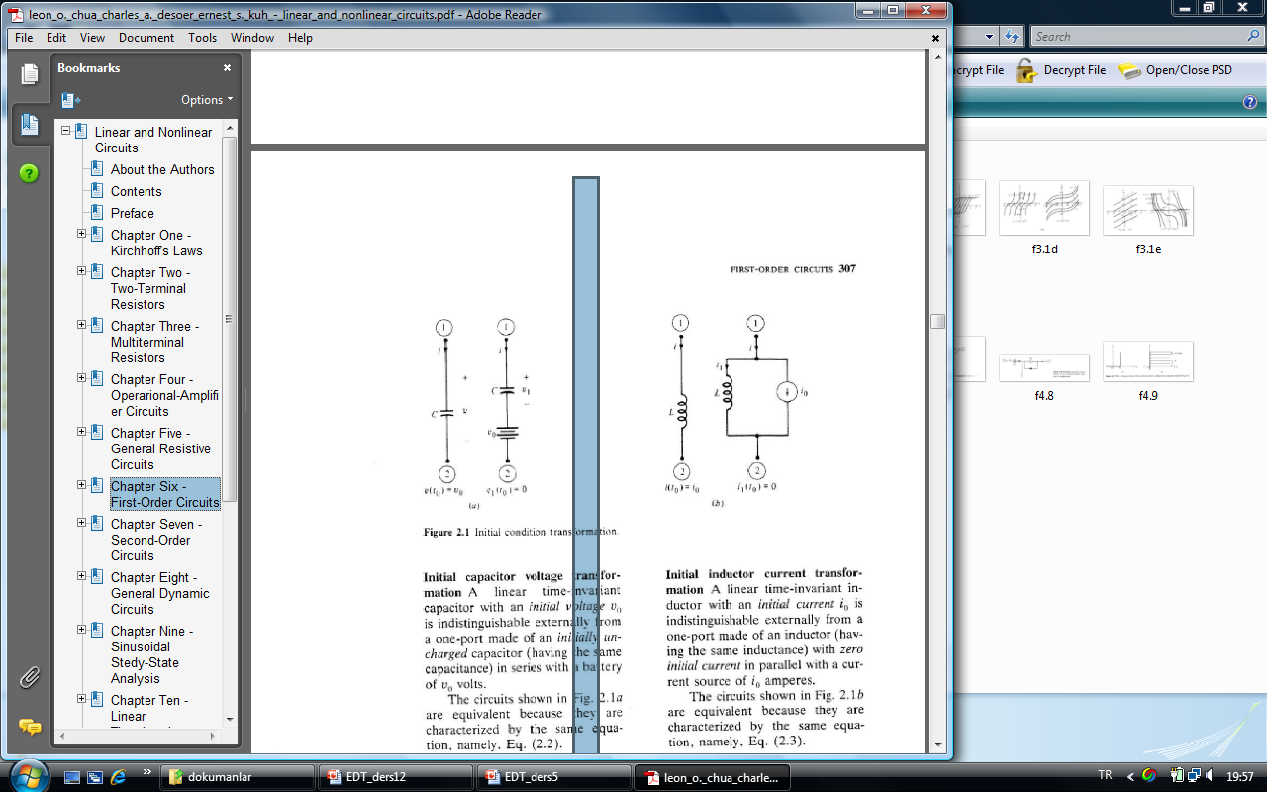
2-Terminal Capacitors and Inductors
Capacitor
linear and time-invariant
Inductor
In order to model nonlinear and or time-varying capacitors and inductors and are used:
L.O. Chua, C.A. Desoer, S.E. Kuh. “Linear and Nonlinear Circuits” Mc.Graw Hill, 1987, New York

Slide 3
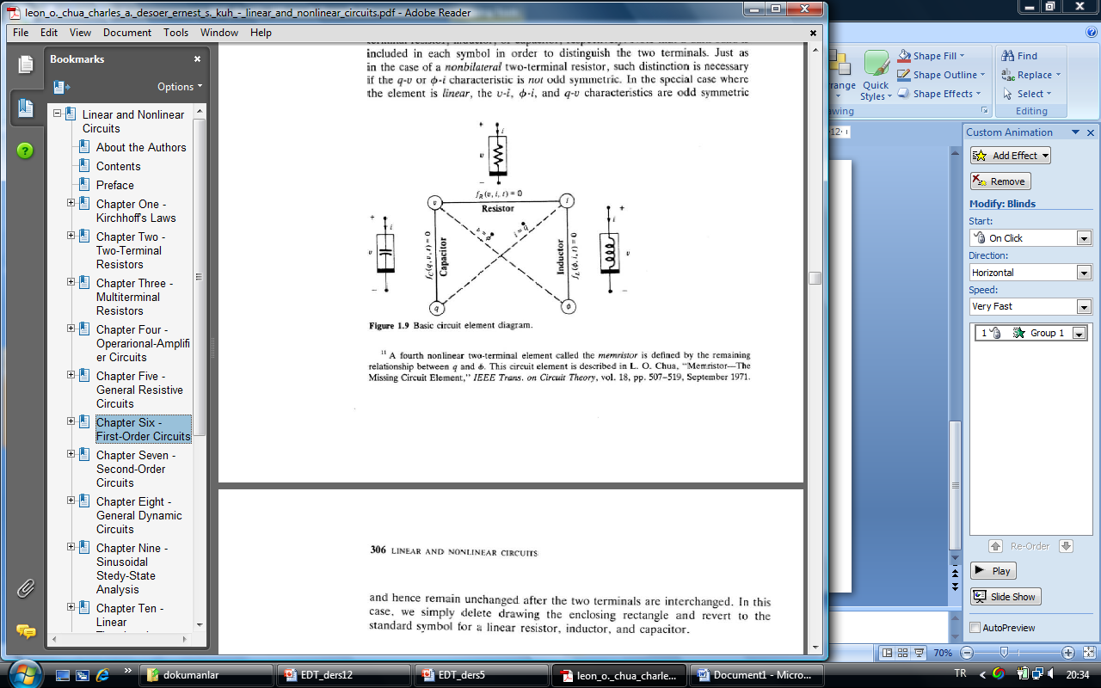
Capacitor
Inductor
charge-controlled
flux-controlled
voltage-controlled
current-controlled
If is differentiable
If is differentiable

Slide 4
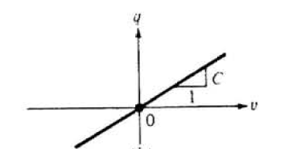
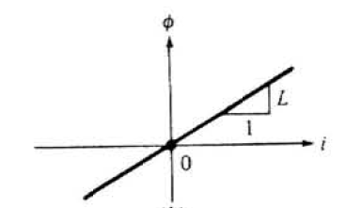
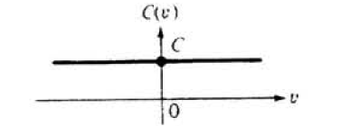
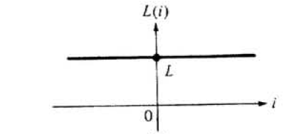
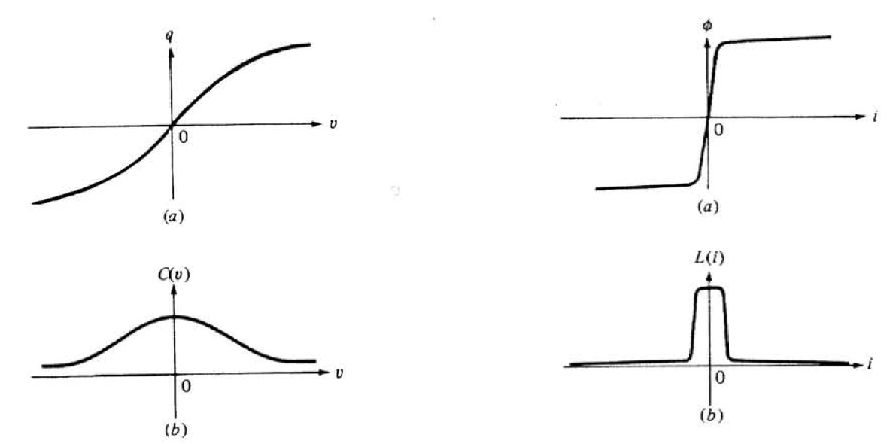
Linear and time-invariant
Kapasite
Endüktans
Nonlinear and time-invariant
L.O. Chua, C.A. Desoer, S.E. Kuh. “Linear and Nonlinear Circuits” Mc.Graw Hill, 1987, New York

Slide 5
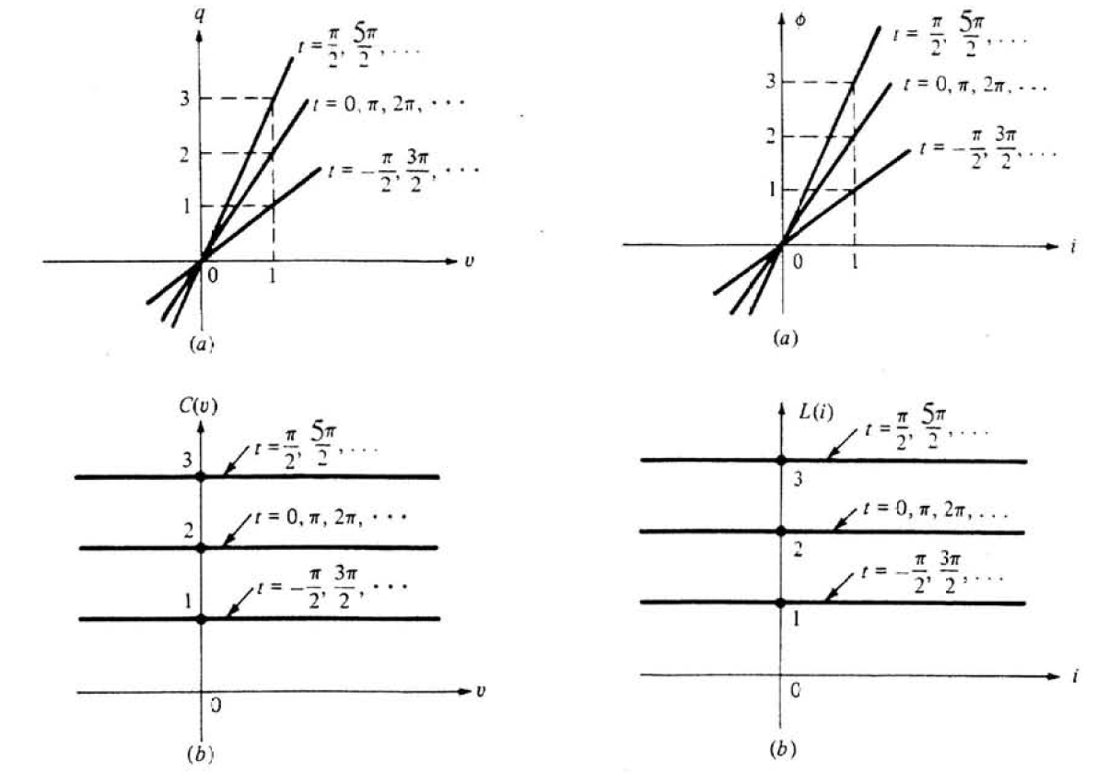
Linear and time-varying
Capacitor
Inductor
L.O. Chua, C.A. Desoer, S.E. Kuh. “Linear and Nonlinear Circuits” Mc.Graw Hill, 1987, New York

Slide 6
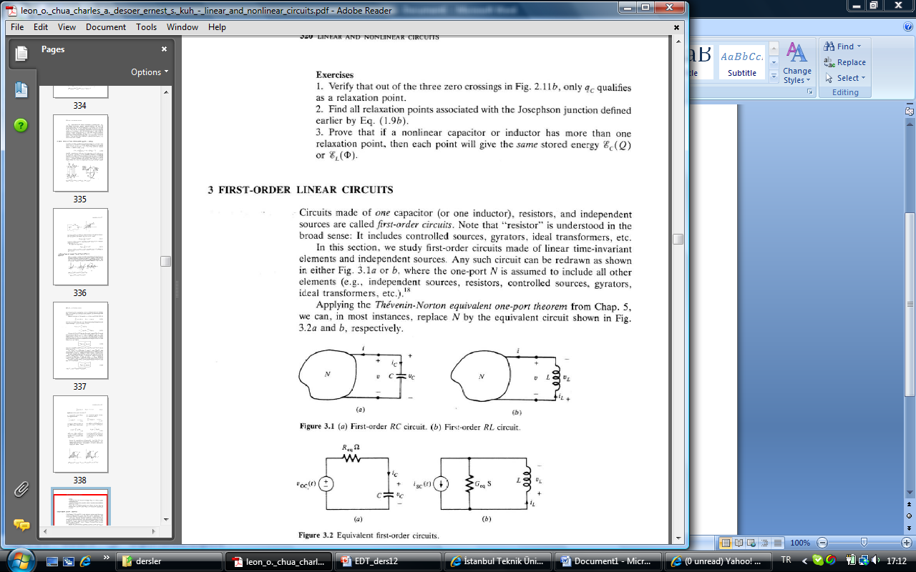
First-Order Linear Circuits
EE+KVL
EE+KCL
State Equations, Kalman (1960)
L.O. Chua, C.A. Desoer, S.E. Kuh. “Linear and Nonlinear Circuits” Mc.Graw Hill, 1987, New York

Slide 7
Solutions of First-Order Differential Equations
Assumption:

Slide 8
Assumption:
0
zero-state
response
zero-state
response

Slide 9
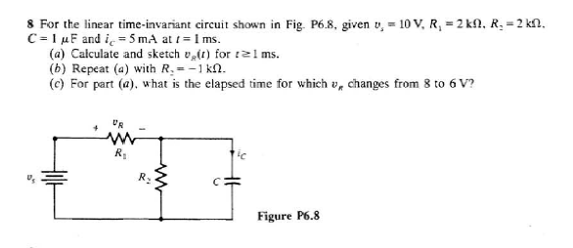
An Example
L.O. Chua, C.A. Desoer, S.E. Kuh. “Linear and Nonlinear Circuits” Mc.Graw Hill, 1987, New York

